Slide 1
Solving water crisis in Tanzania
Dhaval Patel [ 200439819 ]

Slide 2
Index
UN Goals
Project idea
Background
Constraints and barriers
Problem Statement
Project Plan

Slide 3




UN Sustainable Development Goals
Goal 6 - Clean water and sanitation
Goal 3 – Good Health and Well-Being
Ensure access to water and sanitation for all
Ensure healthy lives and promote well-being for all at all ages.
Goal 17 – Partnerships for Goals
Goal 11 – Sustainable Cities and communities
Revitalize the global partnership for sustainable development
Make Communities inclusive, safe, resilient and sustainable

Slide 4
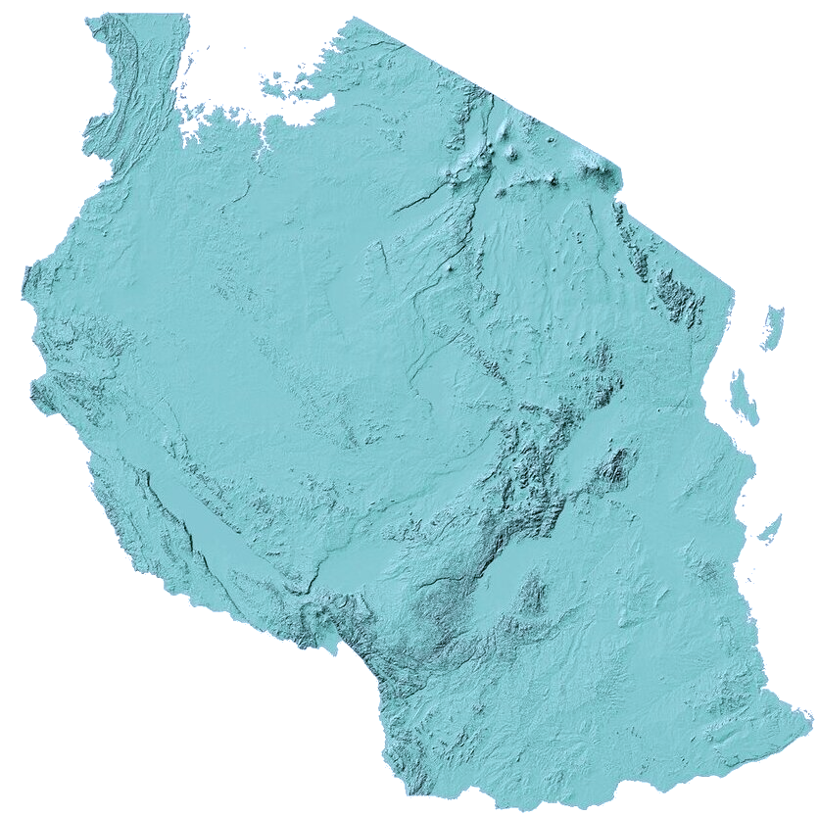
Background
funding gap of 61% to develop infrastructure for safe water
50% population without safe water
4000 Children Died past year due to water born disease
30 minutes round trip for access to clean water
85% of the total population lives on less than $3.20 per day
8 out of 10 people do not have access to access to proper sanitation facilities

Slide 5
Problem Statement
The objective of the project is to create a configuration which aid in solving the water crisis in Tanzania.
Presently there are no tools or platform available that can aid to predict if the water pump is operational or not
Many people have to face water scarcity when water pump fails and does not have a technician assigned to repair it in time
There is no dedicated configurations for articulating community voices on the water crisis
Bring change on grass root level and work on current infrastructure to bring positive change for communities.

Slide 6
Proposed Idea
Proposed Idea would be to design a configuration that can provide following major functionality
use to predict if the water pump is operational or not
Provide a unified platform for Discussion
The Configuration will be used by following customers
People and Communities of Tanzania [Northstar Customer]
Water Pump infrastructure management agency
Local NGO’s
International NGO’s

Slide 7
Constraints and barriers
Developer’s perspective
Time constraints
Technology constraints
Personal constraints
User’s perspective
Bridging the technology gap and thriving in proposed digital habitat.
Accessibility to infrastructure for accessing the configuration
Doubts regarding the reach of the platform
Doubts about configuration bringing substantial change in communities

Slide 8
Project Plan
MVP 3
MVP 1
MVP 2
Data preprocessing
Training the model
packaging and deploying the model
Crafting the UI for making prediction
Plot map of the water pumps
Home Page
Announcement Page
16th June 2021
MVP 2
Sprint 3
MVP 1
6th June 2021
Sprint 2
MVP 3
30th may 2021
Chat Forum
Admin Panel
Sprint 1
19th may 2021

Slide 9
References
PQ-HIV. www.pq-hiv.de/en/chapter/levels-participation. Accessed 17 May 2021.
Wikipedia. Languages of Tanzania. en.wikipedia.org/wiki/Languages_of_Tanzania. Accessed 18 May 2021.
Statista. www.statista.com/statistics/266808/the-most-spoken-languages-worldwide/. Accessed 18 May 2021.
Data Portal. datareportal.com/reports/digital-2021 tanzania#:~:text=Social%20media%20statistics%20for%20Tanzania,total%20population%20in%20January%202021.. Accessed 18 May 2021.

Slide 10
Thank you
Questions ?

